Slide 1
CELLULAR AUTOMATA
TOC PROJECT VIDEO-2
SURAJ P
19BCE1044

Slide 2
CONWAY’S GAME OF LIFE
It is a two-dimensional Cellular Automaton
This is an example of how cellular automata can simulate real-world systems.
The initial start state of this grid can be chosen to be any value between 0 and 1 and the based on the rules of neighbouring cells life is created!!
Just like any other Cellular Automata we calculate a new state by looking at all previous neighbouring states

Slide 3

ALGORITHM - IMPLEMENTATION

Slide 4
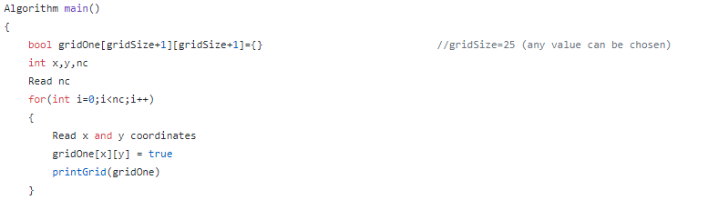
STEP : Generating Grid and Start State

Slide 5
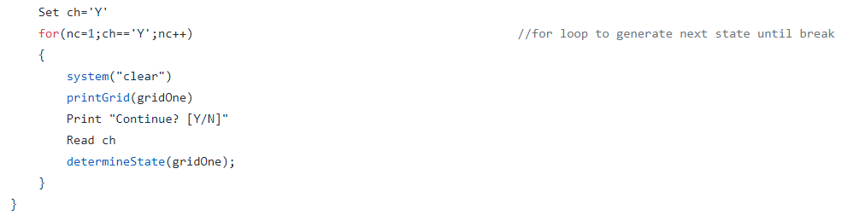

Slide 6
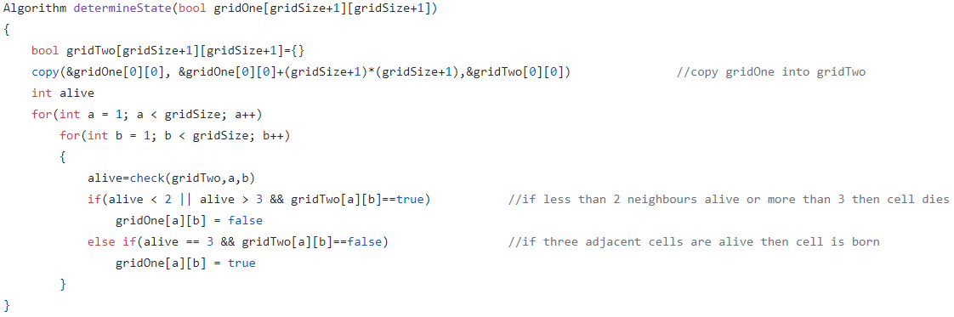
STEP : Generate Next State based on Rules

Slide 7
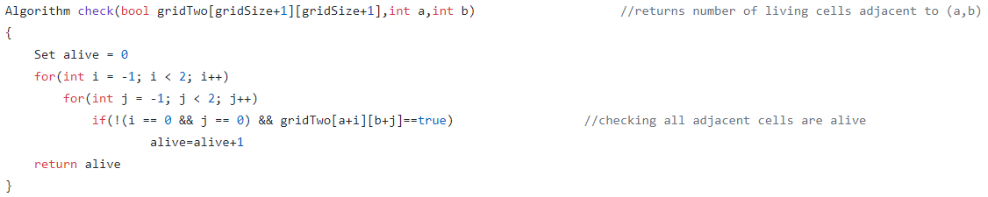
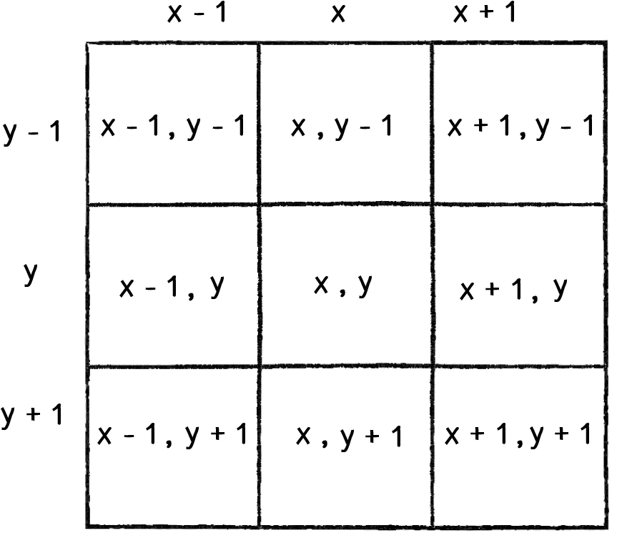
STATES OF NEIGHBOURING CELLS

Slide 8
THE RULES
A cell can die if
The cell is alive and has fewer than two live neighbours (loneliness)
The cell is alive and has more than three live neighbours (overpopulation)
A cell can reborn if
The cell is dead and has exactly three live neighbours (reproduction)

Slide 9
STEP : Generate Next State based on Rules

Slide 10
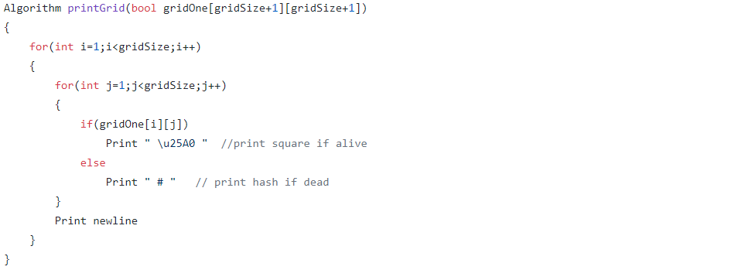
Auxiliary Function : printGrid()

Slide 11
1. Generate a 2D Grid 2. Enter coordinates of the initial state for the Living Cells by setting grid value = true 3. Traverse through the Grid to each cell (a,b) and find the number of living cells in its neighbourhood 4. Based on Rules set whether that cell is alive or dead 5.Print the Grid
SUMMARY

Slide 12
TIME COMPLEXITY
The Time Complexity is O(n*m) or O(n²) where m and n are the dimensions of the grid(here m=n)
We need to traverse through each element in the Grid to find its neighbouring cell’s state. Hence we get a O(n²) time complexity

Slide 13
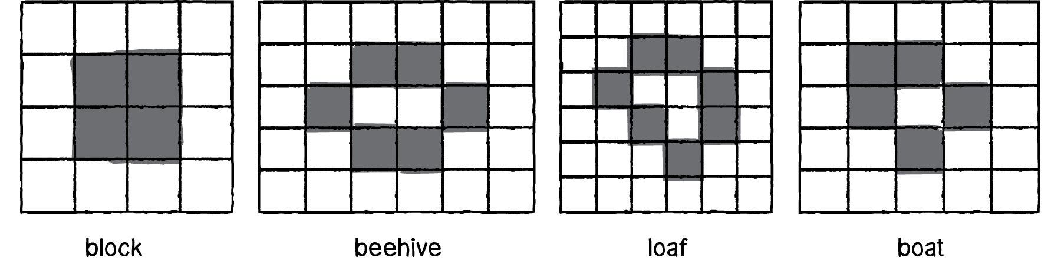
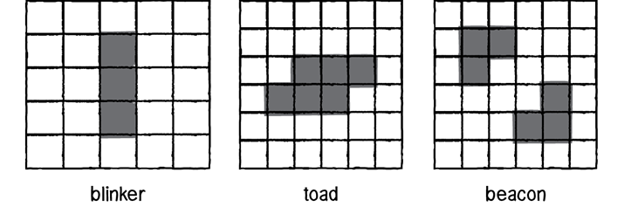
PATTERNS-EXAMPLES
STATIC PATTERNS
OSCILLATING PATTERNS

Slide 14
SOURCE CODE LINK
https://github.com/Surajpedd/Cellular-Automata/blob/main/GameofLife.cpp

Slide 15
THANK YOU

